Slide 1
Neural Network Models for Object Recognition Using Multi-Track ML Approaches
Name: Majed Alzaabi.
Student ID: 12698105

Slide 2
Contents
Project Overview.
Data Preparation and Dataset splitting.
Validation Set Rationale.
Model Selection.
Architecture & Hyperparameters.
Performance Metrics.
Training Strategy.
Comparative Discussion.
Conclusions.

Slide 3
Project Overview
Assignment Topic:
Neural Network Models for Object Recognition Using Multi-Track ML Approaches.
Background:
Artificial Intelligence (AI) is revolutionizing industries by enabling automated object recognition. This technology powers key applications such as ,Krizhevsky (2009):
Self-driving cars (road sign and object detection)
Face ID and biometric authentication
Video surveillance and security systems

Slide 4
Project Objective
Project Objective:
To build and evaluate object recognition models using the CIFAR-10 dataset while comparing multiple machine learning tracks:
Track 1: Classical ML (e.g., Feature Engineering + SVM/KNN)
Track 2: Deep Learning (e.g., CNNs and Transfer Learning)
Track 3: Advanced ML (e.g., Self-Supervised Learning & Neural Architecture Search)
Implementation Requirements:
Design and train a neural network on CIFAR-10
Partition a validation set from the training data
Assess model performance using metrics such as accuracy, precision, and recall
Compare the outcomes across the three ML tracks
Outcome:
By the end of this project, the model's strengths and limitations will be analyzed, and a comparative understanding of ML approaches in object recognition will be developed.

Slide 5
Data Preparation and Dataset splitting.
Dataset Used:
CIFAR-10 (60,000 images, 10 classes, 32x32 RGB).
Data Split:
Training set: 40,000 images,LeCun et al. (2015); .
Validation set: 10,000 images.
Test set: 10,000 images.
Preprocessing steps:
Image reshaping.
Normalization [0,1].

Slide 6
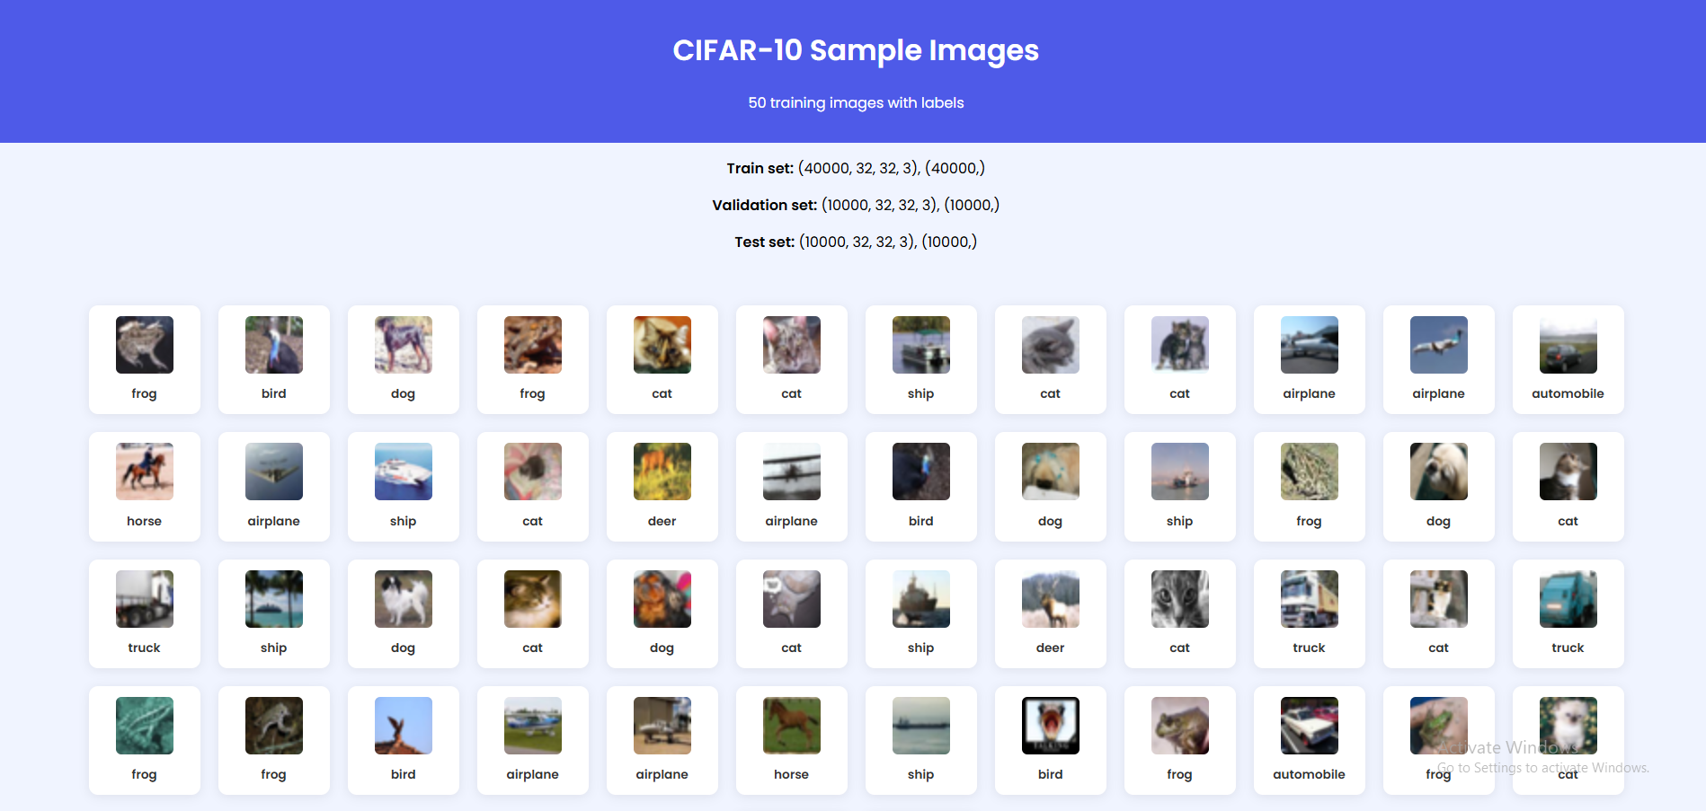
Data Preparation and Dataset splitting.

Slide 7
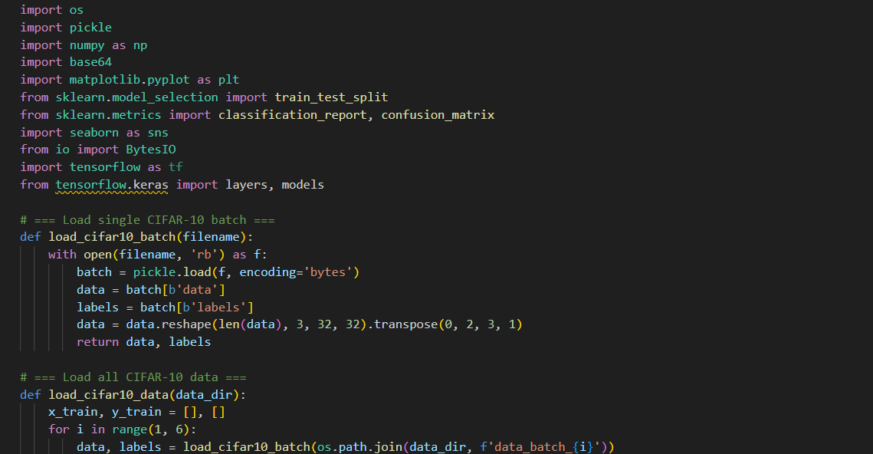
Data Preparation - Code Snippets

Slide 8
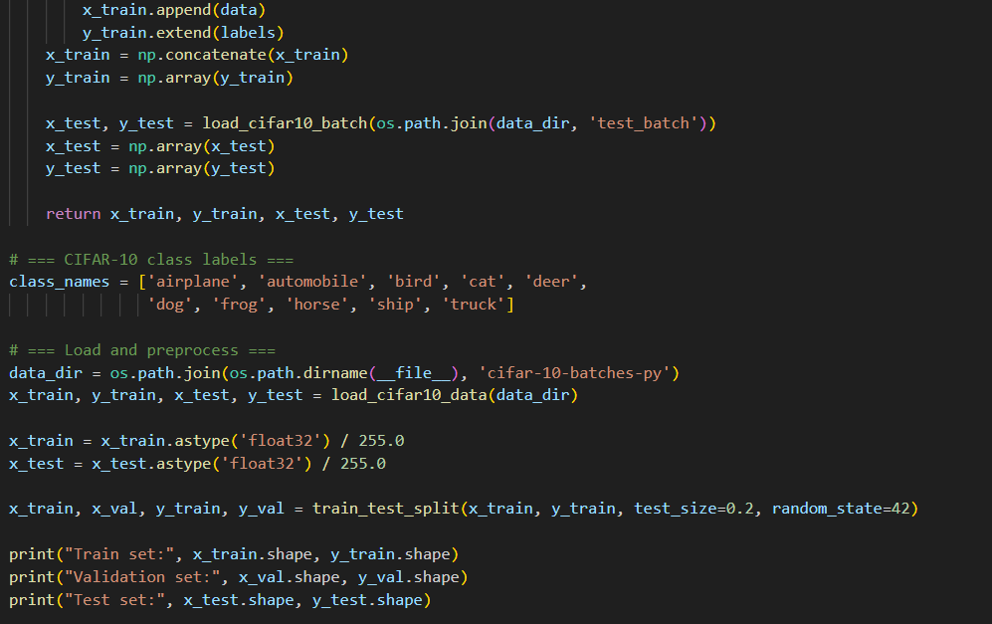
Data Preparation - Code Snippets

Slide 9
Validation Set Rationale.
Importance of Validation Set Rationale:
Used to fine-tune the model – helps choose the best settings (like learning rate, layers, filters) Pedregosa et al. (2011).
Separate from training data – not used to train, only to check performance.
Helps prevent overfitting - if training accuracy is high but validation is low , the model is memorizing , not learning.

Slide 10






Model Selection.
Model Selection : Track 2: Convolutional Neural Networks (CNNs), He et al. (2016):
Designed for image data CNNs work best with spatial features like edges, shapes, textures.
Automatic feature extraction
earn to identify and extract relevant patterns or characteristics from raw input data (such as images) without manual intervention
Captures patterns hierarchically
from simple edges to complex objects.
Proven performance state-of-the-art results on CIFAR-10 and other vision benchmarks.
Efficient parameter sharing
fewer weights, faster training than fully connected networks.
choice fits the Deep Learning track
perfect for multi-class image classification tasks like CIFAR-10.

Slide 11
Architecture & Hyperparameters.
Architecture Rationale:
Input shape:(32, 32, 3) — standard for CIFAR-10 images (RGB, 32×32).
Convolutional Layers:
3 Conv layers with increasing filters: 32 → 64 → 64.
Kernel size: 3×3 for capturing local spatial features.
Activation: ReLU to introduce non-linearity and avoid vanishing gradients.
Pooling Layers: MaxPooling (2×2) after first and second conv layers to reduce spatial dimensions and computation.
Dense Layers:
Flatten() to convert 3D features to 1D.
One Dense layer with 64 units + ReLU for learning high-level patterns.
Final Dense layer with 10 units + Softmax for multiclass classification (10 CIFAR-10 classes) Zoph & Le (2017); .

Slide 12
Architecture & Hyperparameters.
Hyperparameters Chosen, Kornblith et al. (2019):
Hyperparameter | Value | Rationale
Optimizer | Adam | Adaptive learning, good convergence
Loss Function | SparseCategoricalCrossentropy | Suitable for integer labels
Batch Size | 64 | Balance between speed and stability
Epochs | 10 | Enough to show convergence without overfitting
Validation Split | 20% from training set | For unbiased performance monitoring
Learning Rate | Default (Adam's internal) | No tuning done yet

Slide 13
Performance Metrics.
Objective:
Evaluate the trained CNN model using standard classification metrics such as accuracy, precision, recall , F1- score , and confusion matrix , Géron, A. (2019).
Key Metrics Evaluated:
Accuracy: Achieved 70% test accuracy on CIFAR-10 dataset.
Precision & Recall: Assessed for each class using classification_report.
F1-Score: Provided a balanced view of precision and recall.
Confusion Matrix: Visualized true vs. predicted labels.
Visual Evidence:
Confusion matrix highlighted strong classification for vehicles (automobile, truck, ship).
Misclassifications were common between visually similar classes (e.g., cat vs. dog).
Training and validation accuracy plots showed consistent upward trends ,Goodfellow et al. (2016); .

Slide 14
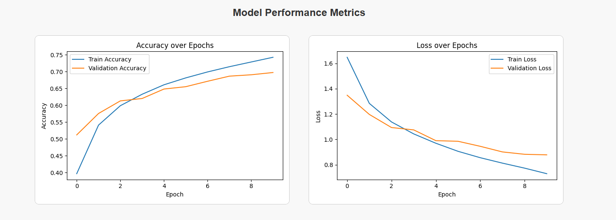

Slide 15
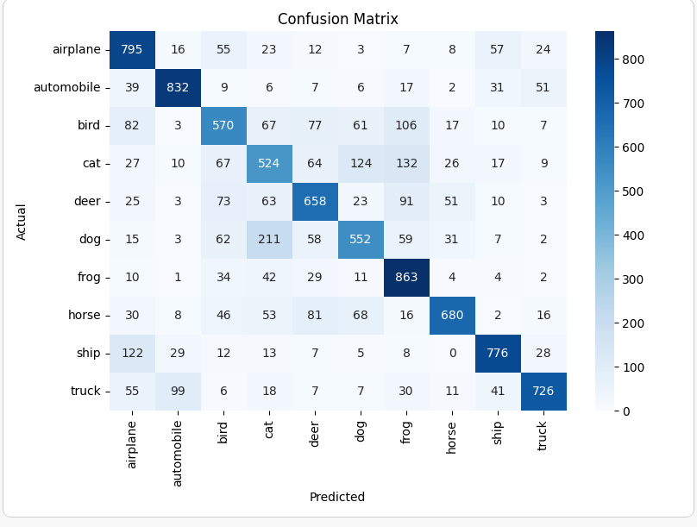

Slide 16
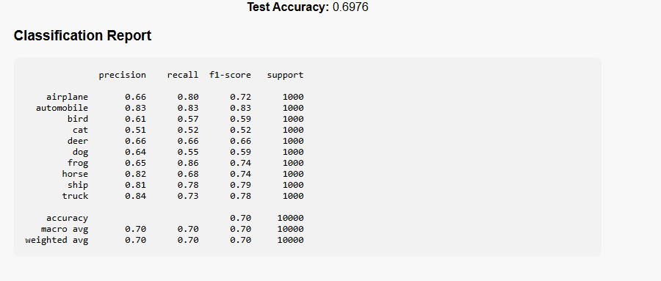

Slide 17
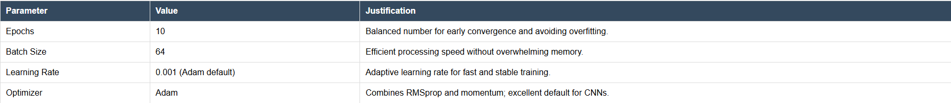
Training Strategy.
Model Training Configuration:
Results Support Strategy:
Accuracy rose from 40% to 74% (train) and 70% (validation) in just 10 epochs.
Training and validation loss consistently decreased with no overfitting detected.
Classification report shows balanced precision/recall across most classes.
Confusion matrix highlights strong predictions for automobile, frog, truck, and ship.
Next Steps:
Add data augmentation to boost generalization.
Use learning rate scheduling or early stopping.
Explore deeper architectures like ResNet for improved performance.
Train longer with increased epoch count if no overfitting is observed

Slide 18
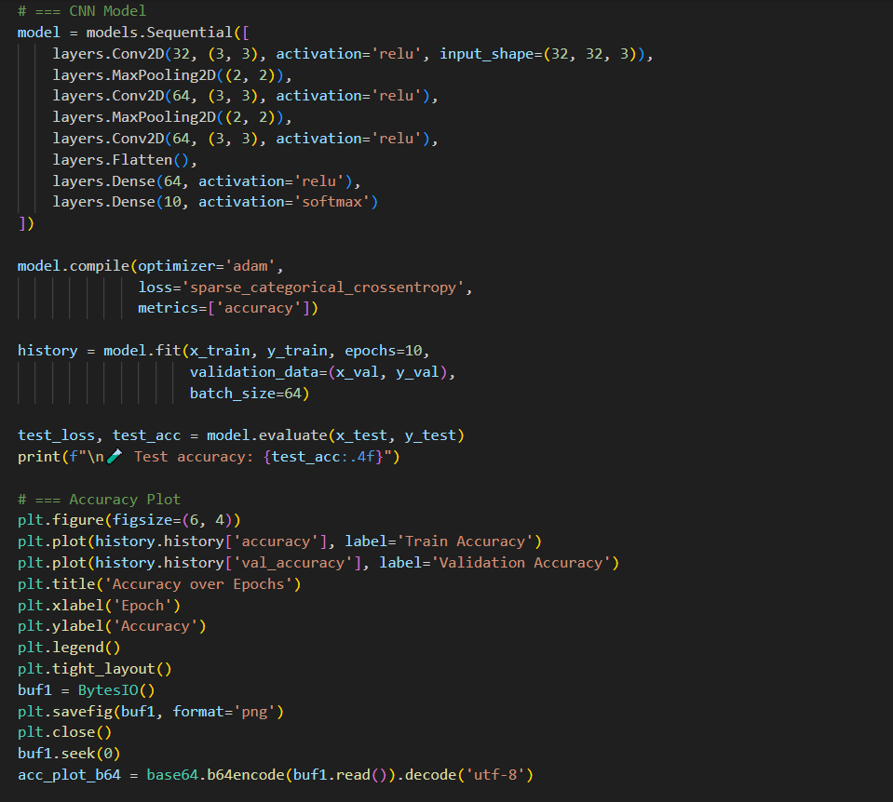
Code Snippets – CNN model , confusion matrix , hyperparameters, classification reports , accuracy plots and loss plots .

Slide 19
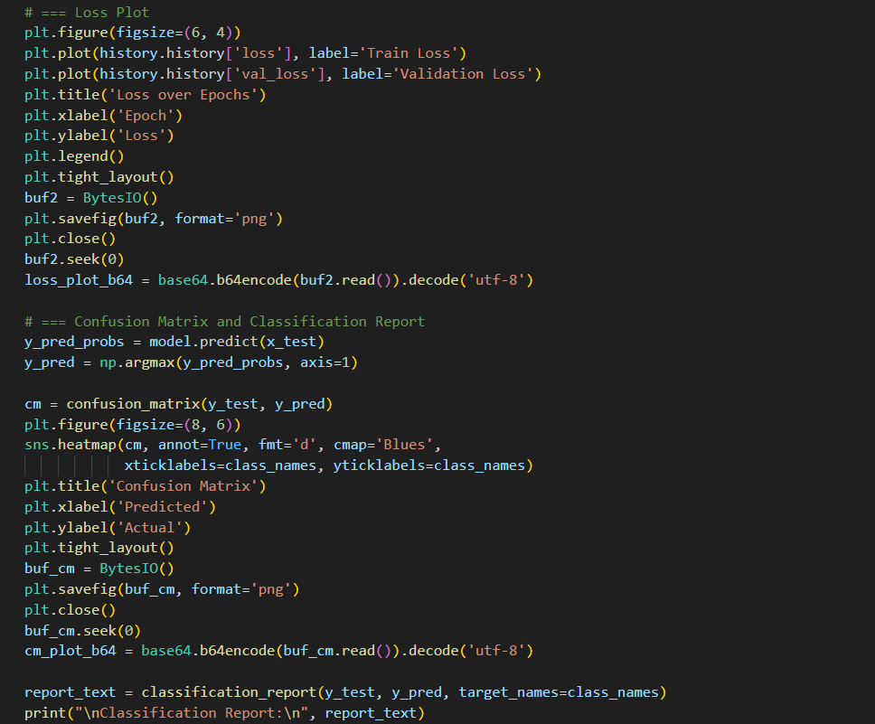
Code Snippets – CNN model , confusion matrix , hyperparameters, classification reports , accuracy plots and loss plots .

Slide 20
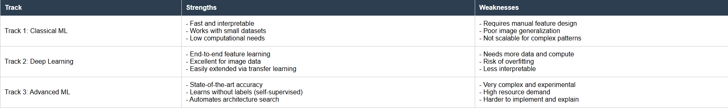
Comparative Discussion.
Strengths and weakness of ML Approach:

Slide 21
Conclusions.
Summary:
Built and evaluated a CNN for CIFAR-10.
Achieved 70% accuracy using a simple 3 – layer architecture.
Knowledge Gained:
Hands on experience building and training CNN model using TensorFlow.
Learned how to preprocess image data and split datasets for training, validation and testing.
Understood the impact of key hyperparameters such as batch size, epochs and optimizers
Learned how to evaluate model performance using accuracy , classification reports and confusion matrices.
Gainde insight into the strengths and limitations of classical vs deep vs advanced ML approaches
Future Improvements:
Implement dropout or batch normalization layers.
Use data augmentation to increase dataset diversity
Explore deeper models (e.g., ResNet, VGG) or pre-trained transfer learning methods
Tune hyperparameters using cross validation or grid search.

Slide 22
References and Appendix.
Krizhevsky, A., Sutskever, I., & Hinton, G. E. (2012). ImageNet classification with deep convolutional neural networks. Advances in Neural Information Processing Systems, 25, 1097–1105. https://doi.org/10.1145/3065386
11. Géron, A. (2019). Hands-on machine learning with Scikit-Learn, Keras, and TensorFlow (2nd ed.). O’Reilly Media.
Pedregosa, F., Varoquaux, G., Gramfort, A., Michel, V., Thirion, B., Grisel, O., ... & Duchesnay, É. (2011). Scikit-learn: Machine learning in Python. Journal of Machine Learning Research, 12, 2825–2830.
Zoph, B., & Le, Q. V. (2017). Neural architecture search with reinforcement learning. International Conference on Learning Representations (ICLR). https://arxiv.org/abs/1611.01578
LeCun, Y., Bengio, Y., & Hinton, G. (2015). Deep learning. Nature, 521(7553), 436–444. https://doi.org/10.1038/nature14539.
Goodfellow, I., Bengio, Y., & Courville, A. (2016). Deep learning. MIT Press. https://www.deeplearningbook.org/
He, K., Zhang, X., Ren, S., & Sun, J. (2016). Deep residual learning for image recognition. Proceedings of the IEEE Conference on Computer Vision and Pattern Recognition (CVPR), 770–778. https://doi.org/10.1109/CVPR.2016.90
Chen, T., Kornblith, S., Norouzi, M., & Hinton, G. (2020). A simple framework for contrastive learning of visual representations. International Conference on Machine Learning (ICML), 1597–1607. https://arxiv.org/abs/2002.05709

